Slide 1
Chapter 8
Inference for Proportions
Lecture Slides
Introduction to the Practice of Statistics
Tenth Edition
David S. Moore George P. McCabe
Bruce Craig

Slide 2
Chapter 8
Inference for Proportions
8.1 Inference for a Single Proportion
8.2 Comparing Two Proportions

Slide 3
8.1 Inference for a Single Proportion
Large-sample confidence interval for a single proportion
The plus four confidence interval for a single proportion
Significance test for a single proportion
Choosing a sample size for a confidence interval
Choosing a sample size for a significance test

Slide 4
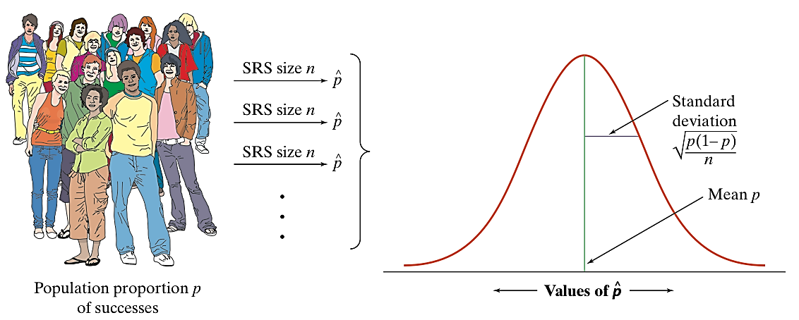
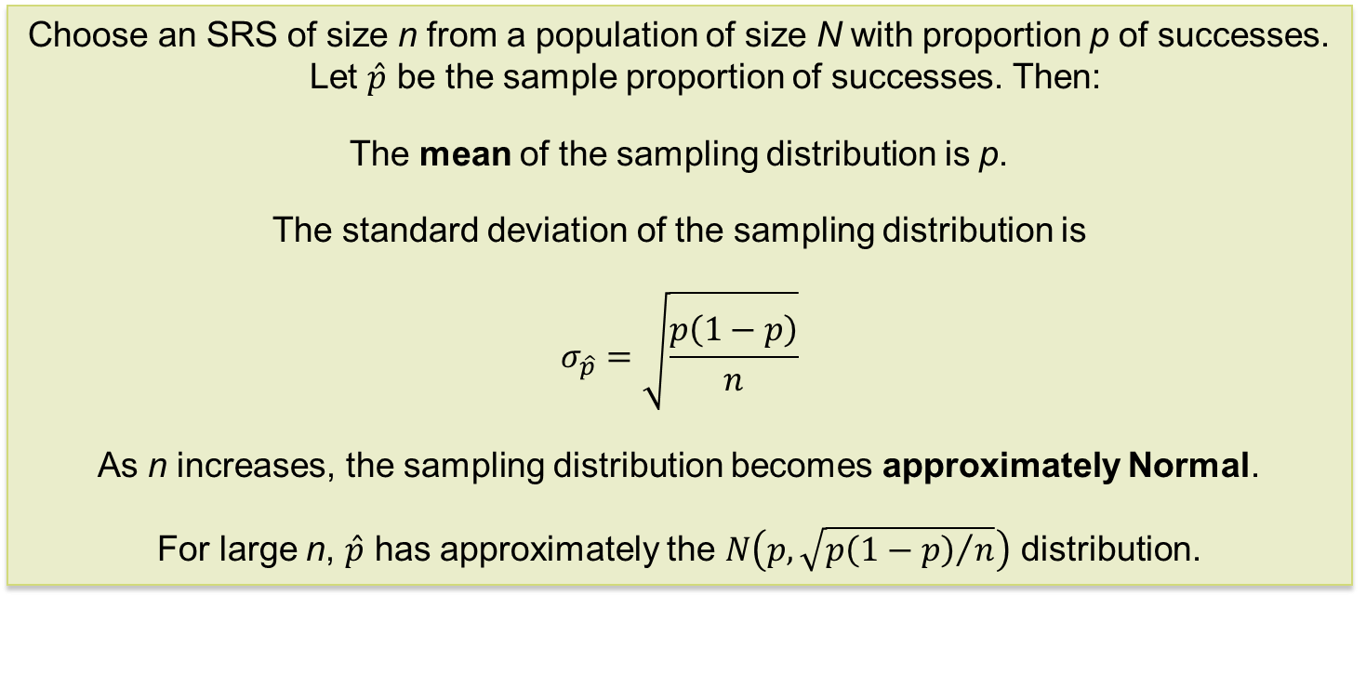
Sampling Distribution of a Sample Proportion
Sampling Distribution of a Sample Proportion
Choose an SRS of size n from a population of size N with proportion p of successes. Let $\hat{p}$ be the sample proportion of successes. Then:
The mean of the sampling distribution is p.
The standard deviation of the sampling distribution is
$$σ_{\hat{p}}=\sqrt{\frac{p\left(1−p\right)}{n}}$$
As n increases, the sampling distribution becomes approximately Normal.
For large n, $\hat{p}$ has approximately the $N\left(p, \sqrt{{p\left(1−p\right)}/n}\right)$ distribution.

Slide 5
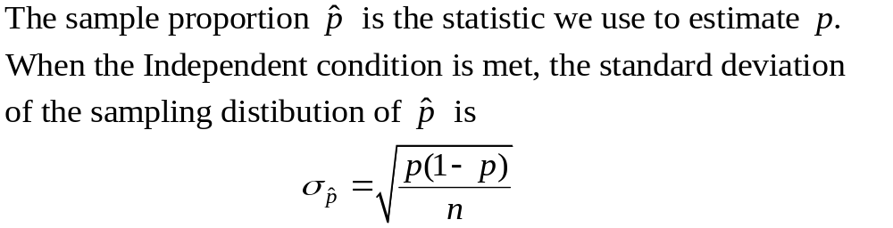
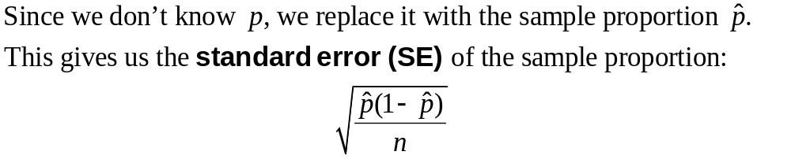
Large-Sample Confidence Interval for a Single Proportion 1
We can use the same path from sampling distribution to confidence interval as we did with means to construct a confidence interval for an unknown population proportion p:

Slide 6
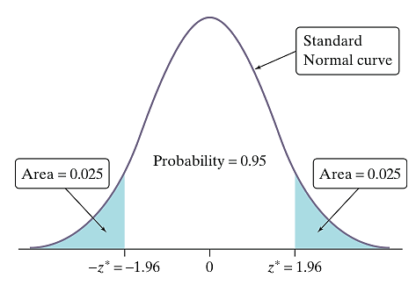
Large-Sample Confidence Interval for a Single Proportion 2
How do we find the critical value for our confidence interval?
If the Normal condition is met, we can use a Normal curve. To find a level C confidence interval, we need to catch the central area C under the standard Normal curve.
Example: To find a 95% confidence interval, we use an approximate critical value of 2 based on the 68-95-99.7 rule. Using a standard Normal table or a calculator, we can get a more accurate critical value.
Note that the critical value z* is actually 1.96 for a 95% confidence level.

Slide 7
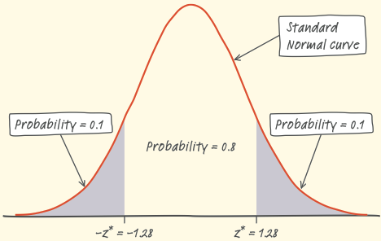
Large-Sample Confidence Interval for a Single Proportion 3
Example: Find the critical value z* for an 80% confidence interval. Assume that the Normal condition is met.
Because we want to capture the central 80% of the standard Normal distribution, we leave out 20%, or 10% in each tail.
Search Table A to find the point z* with area 0.1 to its left.
z | .07 | .08 | .09
– 1.3 | .0853 | .0838 | .0823
– 1.2 | .1020 | .1003 | .0985
– 1.1 | .1210 | .1190 | .1170
The closest entry is z = –1.28.
Thus the critical value z* for an 80% confidence interval is z* = 1.28.

Slide 8
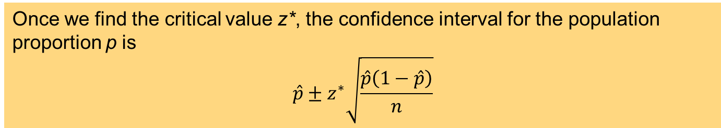
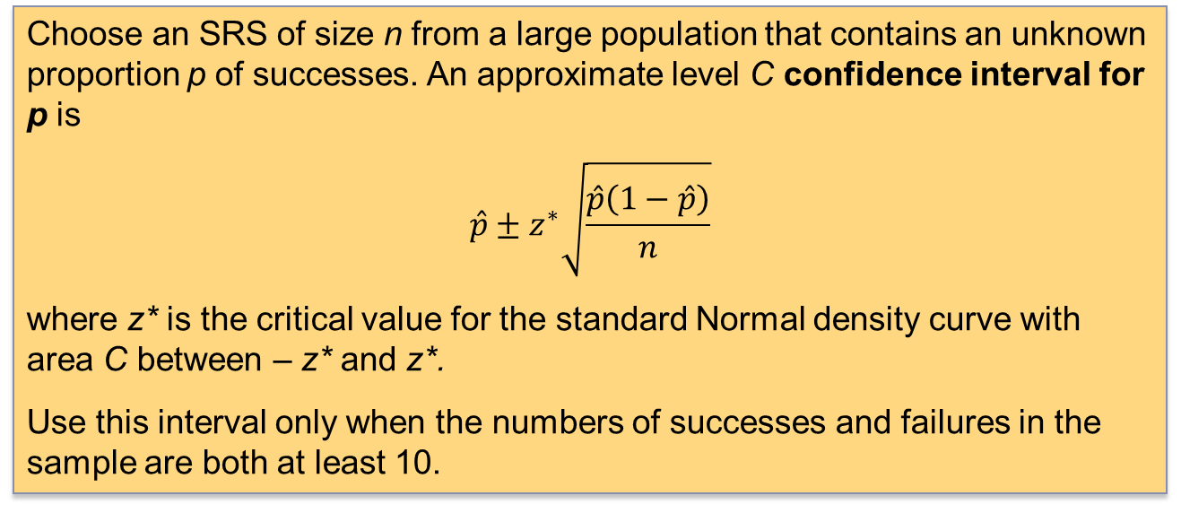
Large-Sample Confidence Interval for a Single Proportion 4
Once we find the critical value z*, the confidence interval for the population proportion p is
$$\hat{p}±z^{∗}\sqrt{\frac{\hat{p}\left(1−\hat{p}\right)}{n}}$$
One-Sample z Interval for a Population Proportion
Choose an SRS of size n from a large population that contains an unknown proportion p of successes. An approximate level C confidence interval for p is
$$\hat{p}±z^{∗}\sqrt{\frac{\hat{p}\left(1−\hat{p}\right)}{n}}$$
where z* is the critical value for the standard Normal density curve with area C between – z* and z*.
Use this interval only when the numbers of successes and failures in the sample are both at least 10.

Slide 9
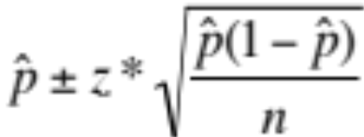
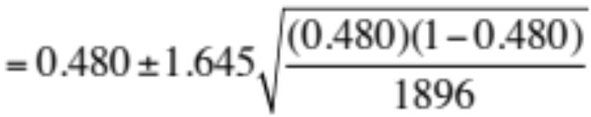
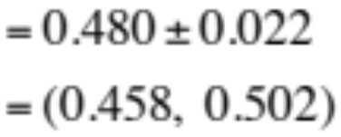
Large-Sample Confidence Interval for a Single Proportion Example
Example: A Pew survey asked a panel of experts whether they thought robotic devices will have displaced more jobs than they have created by 2025. Out of 1896 experts, 910 said yes. Calculate and interpret a 90% confidence interval for the proportion of experts who believe net jobs will decrease due to robotics.
z | .03 | .04 | .05
– 1.7 | .0418 | .0409 | .0401
– 1.6 | .0516 | .0505 | .0495
– 1.5 | .0630 | .0618 | .0606
Sample proportion = 910/1896 = 0.480
This is an SRS; there are 910 successes and 986 failures. Both are greater than 10.
For a 90% confidence level, z* = 1.645.
We are 90% confident that the interval from 0.458 to 0.502 captures the actual proportion of experts in the population who believe net jobs will decrease due to robotics.

Slide 10
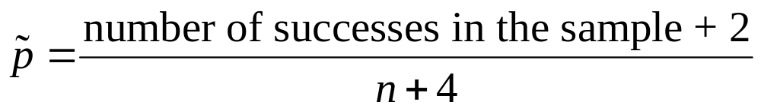
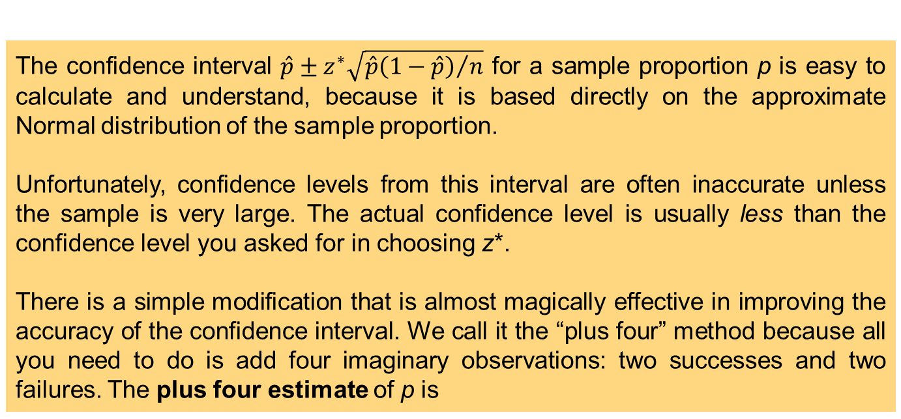
The Plus Four Confidence Interval for a Single Proportion 1
The confidence interval $\hat{p}±z^{∗}\sqrt{{\hat{p}\left(1−\hat{p}\right)}/n}$ for a sample proportion p is easy to calculate and understand, because it is based directly on the approximate Normal distribution of the sample proportion.
Unfortunately, confidence levels from this interval are often inaccurate unless the sample is very large. The actual confidence level is usually less than the confidence level you asked for in choosing z*.
There is a simple modification that is almost magically effective in improving the accuracy of the confidence interval. We call it the “plus four” method because all you need to do is add four imaginary observations: two successes and two failures. The plus four estimate of p is

Slide 11
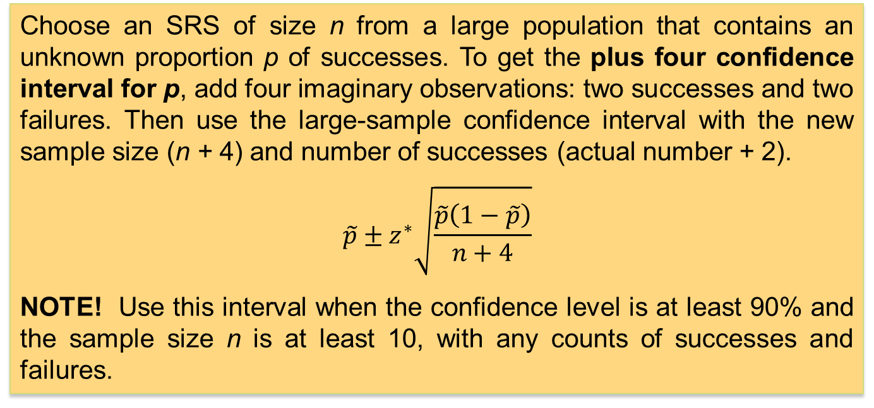
The Plus Four Confidence Interval for a Single Proportion 2
Plus Four Confidence Interval for a Proportion
Choose an SRS of size n from a large population that contains an unknown proportion p of successes. To get the plus four confidence interval for p, add four imaginary observations: two successes and two failures. Then use the large-sample confidence interval with the new sample size (n + 4) and number of successes (actual number + 2).
$$\tilde{p}±z^{∗}\sqrt{\frac{\tilde{p}\left(1−\tilde{p}\right)}{n+4}}$$
NOTE! Use this interval when the confidence level is at least 90% and the sample size n is at least 10, with any counts of successes and failures.

Slide 12
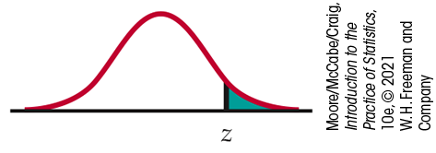

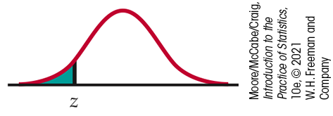

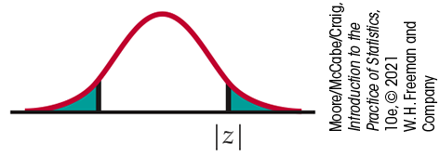

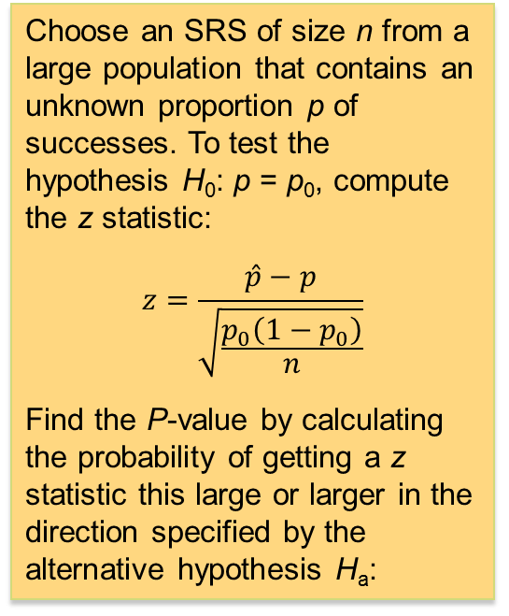
Significance Test for a Single
Proportion
The z statistic has approximately the standard Normal distribution when H₀ is true. P-values therefore come from the standard Normal distribution. Here is a summary of the details for a z test for a proportion.
z Test for a Proportion
Choose an SRS of size n from a large population that contains an unknown proportion p of successes. To test the hypothesis H₀: p = p₀, compute the z statistic:
$$z=\frac{\hat{p}−p}{\sqrt{\frac{p_{0}\left(1−p_{0}\right)}{n}}}$$
Find the P-value by calculating the probability of getting a z statistic this large or larger in the direction specified by the alternative hypothesis H_{a}:

Slide 13
Significance Test for a Single
Proportion Example 1
Example: Your company produces a sunblock lotion designed to protect the skin from UVA and UVB exposure to the sun. You hire a testing company to compare your product with your major competitor’s product. For 13 of 20 randomly chosen subjects, your product provides better protection; for the remaining seven, the competitor’s product does. Do you have evidence to support a commercial claiming that your product provides superior protection?
We want to perform a significance test for
H₀: p = 0.50
H_{a}: p > 0.50
where p is the actual proportion of people for whom your product provides better protection than your competitor’s product.
If conditions are met, we should do a one-sample z test for the population proportion p.
  Random: We assume the testing company chose a random sample of subjects for testing.
  Normal: Assuming H₀: p = 0.50 is true, the expected numbers of successes and failures are np₀ = 20(0.50) = 10 and n(1 – p₀) = 20(1 – 0.50) = 10, respectively. Because both of these values are at least 10, we should be safe doing Normal calculations.

Slide 14
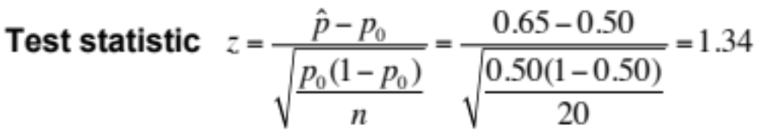

Significance Test for a Single
Proportion Example 2
The sample proportion of successes is $\hat{p}={13}/{20}=0.65$.
P-value. The desired P-value is twice the one-tailed P-value:
2P(z ≥ 1.34) = 2(1 – 0.9099) = 0.1802
Because our P-value, 0.1802, is greater than the usual significance level, we fail to reject H₀. There is not sufficient evidence to support our proposed advertising claim.

Slide 15
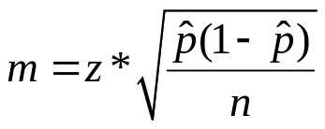
Choosing a Sample Size for a Confidence Interval
In planning a study, we may want to choose a sample size that allows us to estimate a population proportion within a given margin of error.
z* is the standard Normal critical value for the level of confidence we want.

Slide 16
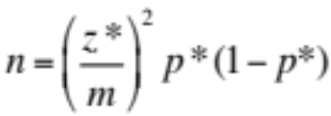
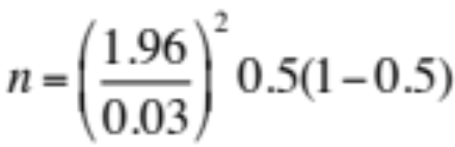

Choosing a Sample Size for a Confidence Interval Example
Example: Suppose your university wishes to determine what percent of students are satisfied with the overall campus environment. Determine the sample size needed to estimate p within 0.03 with 95% confidence.
The critical value for 95% confidence is z* = 1.96.
Because the university wants a margin of error of no more than 0.03, we need to solve the following equation:
We round up to 1068 respondents to ensure the margin of error is no more than 0.03 at 95% confidence.

Slide 17
Choosing a Sample Size for a Significance Test
In Chapter 6, we introduced the idea of power for a significance test. These ideas apply to the significance test for a proportion from this section.
To find the required sample size for a significance test, we need to specify
the value of p₀ in the null hypothesis H₀: p = p₀
the alternative hypothesis, two-sided or one-sided
a value of p for the alternative hypothesis
the Type I error (usually 5%)
the Type II error (usually 80%)
Sample Size for Comparing Two Sunblock Lotions
In the earlier sunblock example, we found our product was better than the competitor’s in 13 out of 20 subjects. However, we failed to reject the null hypothesis (p = 0.18). Let’s suppose that the true value is p₀ = 0.65, and that we plan on a two-sided test at a 5% significance level and 80% power.
Software outputs indicate that n = 85 or 89 should be used.

Slide 18
8.2 Comparing Two Proportions
Large-sample confidence interval for a difference in proportions
Plus four confidence interval for a difference in proportions
Significance test for a difference in proportions
Choosing a sample size for two sample proportions
Relative risk

Slide 19
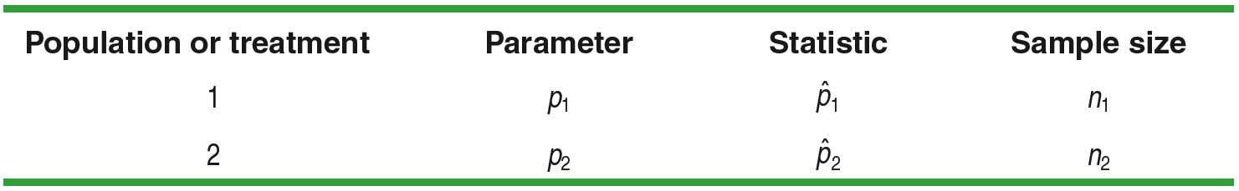
Two-Sample Problems: Proportions
Example: Suppose we want to compare the proportions of individuals who have a certain characteristic in Population 1 and Population 2. Let’s call these parameters of interest p₁ and p₂. The ideal strategy is to take a separate random sample from each population and compare the sample proportions with that characteristic.
What if we want to compare the effectiveness of Treatment 1 and that of Treatment 2 in a completely randomized experiment? This time, the parameters p₁ and p₂ that we want to compare are the true proportions of successful outcomes for each treatment. We use the proportions of successes in the two treatment groups to make the comparison. Here’s a table that summarizes these two situations:

Slide 20
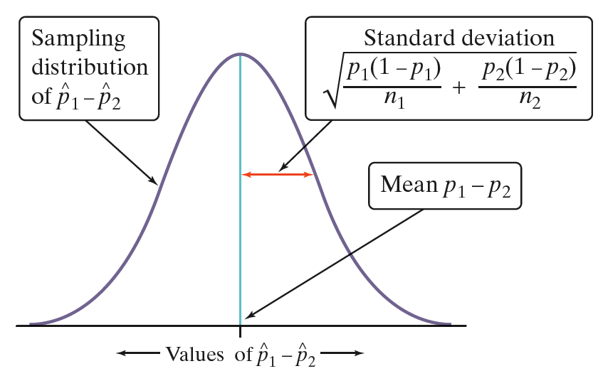
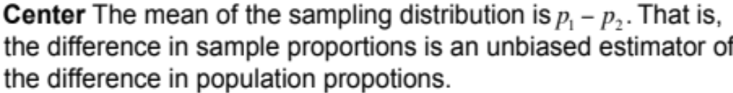
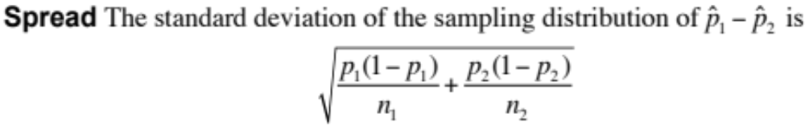
Sampling Distribution of a Difference between Proportions
The Sampling Distribution of the Difference Between Proportions
Choose an SRS of size n₁ from Population 1 with proportion of successes
p₁ and an independent SRS of size n₂ from Population 2 with proportion of
successes p₂.

Slide 21
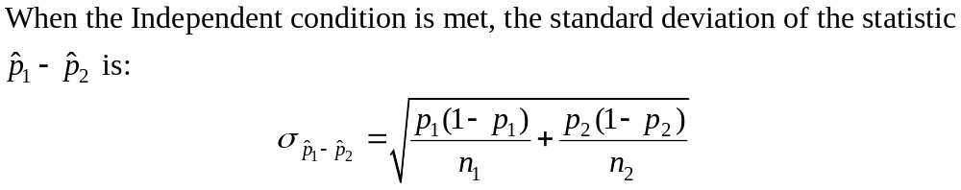
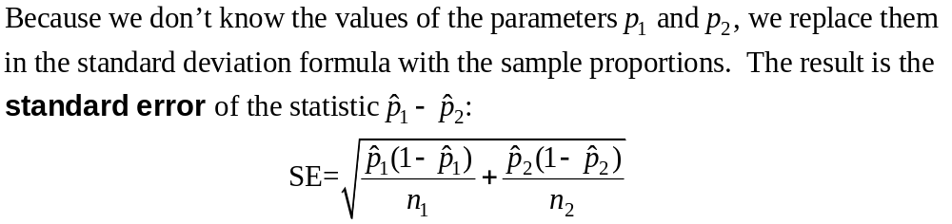
Large-Sample Confidence Interval for Comparing Proportions

Slide 22
Large-Sample Confidence Interval for Comparing Proportions Example 1
Example: A recent study compared the proportions of young women and men who use Instagram. A total of 537 young women and 532 young men were surveyed. 328 of the women and 234 of the men stated that they use Instagram. For the women, the proportion who use Instagram was 328/537 = 0.6108; for the men, the proportion who use Instagram was 234/532 = 0.4398.
Our parameters of interest are p₁ = the proportion of all young women who use Instagram, and p₂ = the proportion of all young men who use Instagram. We want to estimate the difference p₁ – p₂ at a 95% confidence level.
We should use a large-sample confidence interval for p₁ – p₂ if the conditions are satisfied.
Random: The data come from a random sample of 1069 young women and men.
Normal: We check the counts of “successes” and “failures” and note that the Normal condition is met because they are all greater than 10.

Slide 23
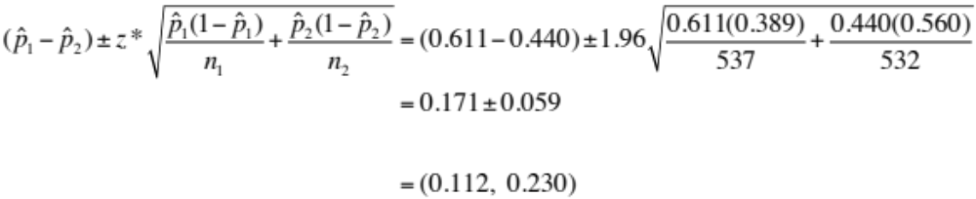
Large-Sample Confidence Interval for Comparing Proportions Example 2
Because the conditions are satisfied, we can construct a two-sample z interval for the difference p₁ – p₂.
We are 95% confident that the interval from 0.112 to 0.230 captures the true difference in the proportions of all young women and all young men who use Instagram.
This interval suggests that, by between 11.2 and 23.0 percentage points, more young women than young men use Instagram.

Slide 24
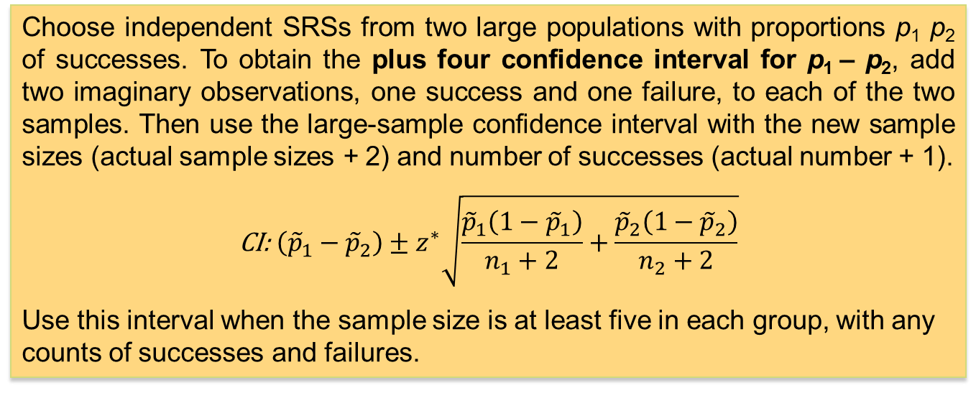
The Plus Four Confidence Intervals for a Difference in Proportions
As with the large-sample confidence interval for a single proportion, the large-sample interval for comparing proportions generally has a true confidence level less than the level you asked for. Once again, adding imaginary observations greatly improves the accuracy.
Plus Four Confidence Interval for Comparing Proportions
Choose independent SRSs from two large populations with proportions p₁ p₂ of successes. To obtain the plus four confidence interval for p₁ – p₂, add two imaginary observations, one success and one failure, to each of the two samples. Then use the large-sample confidence interval with the new sample sizes (actual sample sizes + 2) and number of successes (actual number + 1).
$$\text{CI}\text{: }\left({\tilde{p}}_{1}−{\tilde{p}}_{2}\right)±z^{∗}\sqrt{\frac{{\tilde{p}}_{1}\left(1−{\tilde{p}}_{1}\right)}{n_{1}+2}+\frac{{\tilde{p}}_{2}\left(1−{\tilde{p}}_{2}\right)}{n_{2}+2}}$$
Use this interval when the sample size is at least five in each group, with any counts of successes and failures.

Slide 25
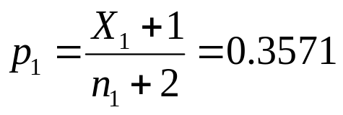
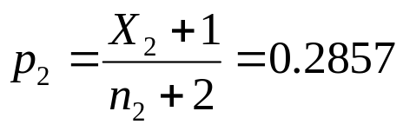
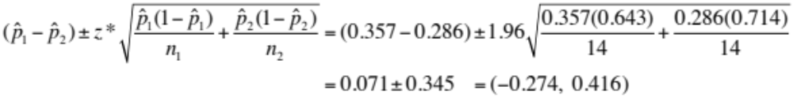
The Plus Four Confidence Intervals for a Difference in Proportions Example
Example: A pilot study included 12 girls and 12 boys from a population for a large experiment. Four of the boys and three of the girls had Tanner scores of 4 or 5 (a high level of sexual maturity).
The numbers of successes and failures in each sample (4, 8, 3, and 9) are not all at least 10, so the large-sample theory does not apply. However, each sample size is at least 5, so the plus four method is appropriate.
We are 95% confident that the interval from –0.274 to 0.416 captures the true difference in the proportions of girls and boys who have a high level of sexual maturity.
This interval suggests that either boys or girls could be more sexually mature in this population and that the difference could be quite large.

Slide 26
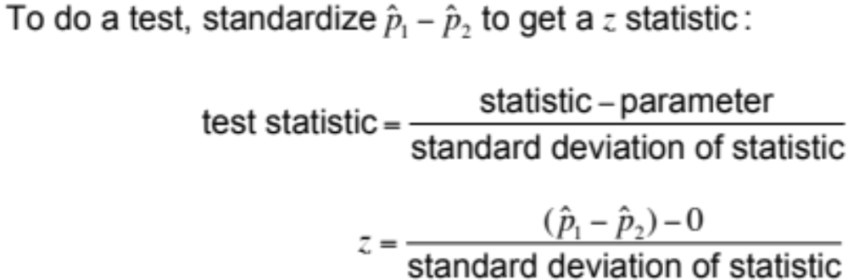
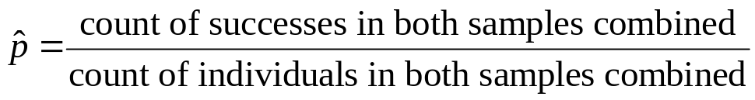
Significance Test for Comparing Proportions 1
An observed difference between two sample proportions can reflect an actual difference in the parameters, or it may just be due to chance variation in random sampling or random assignment. Significance tests help us decide which explanation makes more sense.
If H₀: p₁ = p₂ is true, the two parameters are the same. We call their common value p. But now we need a way to estimate p, so it makes sense to combine the data from the two samples. This pooled (or combined) sample proportion is

Slide 27
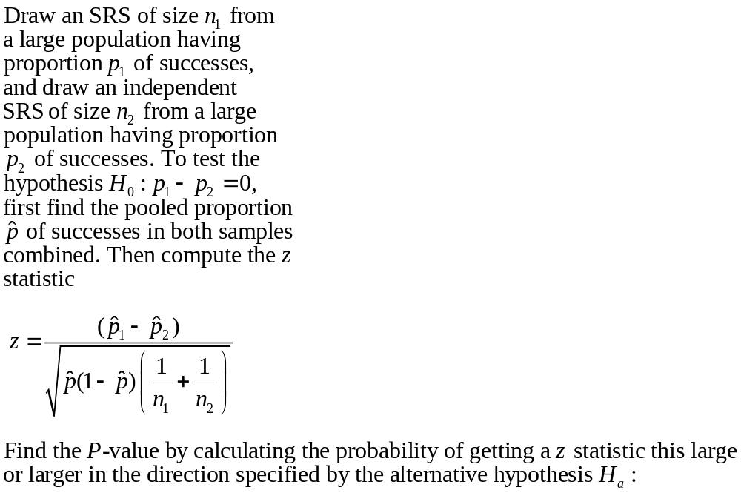

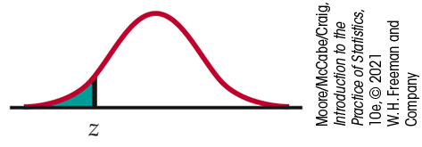


Significance Test for Comparing Proportions 2
Significance Test for Comparing Two Proportions

Slide 28
Significance Test for Comparing Proportions Example 1
Example: Are young women and men equally likely to say they use Instagram? Recall the data from our earlier example: 328 out of 537 women (61.1%) and 234 out of 532 men (44.0%) use Instagram. Perform a significance test to see whether the difference is large enough to lead us to believe that the population proportions are not equal.
Our hypotheses are
H₀: p₁ – p₂ = 0
H_{a}: p₁ – p₂ ≠ 0
where p₁ = the true proportion of young women who use Instagram, and
p₂ = the true proportion of young men who use Instagram.
We should perform a significance test for p₁ – p₂ if the conditions are satisfied.
Random: The data were produced using two simple random samples: 537 young women and 532 young men.
Normal: We check the counts of “successes” and “failures” and note that the Normal condition is met because they are all greater than 5.
Independent: The samples were taken independently of each other because the sample sizes were random.

Slide 29
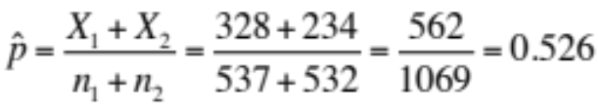
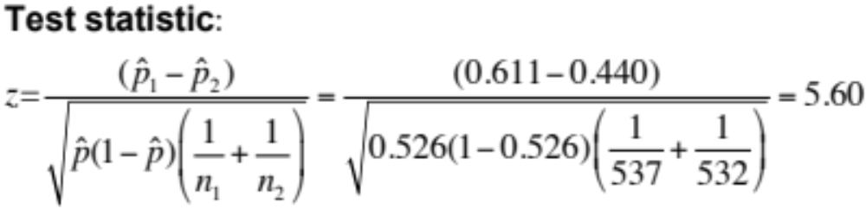
Significance Test for Comparing Proportions Example 2
Because the conditions are satisfied, we can perform a two-sample z test for the difference p₁ – p₂.
P-value Using Table A or Normal cdf, the desired P-value is
2P(z ≥ 5.6) > 2P(z ≥ 3.4) = 2(1 – 0.9998) = 0.0004
Because our P-value, 0.0004, is much smaller than the chosen significance level of α = 0.05, we reject H₀. There is sufficient evidence to conclude that the two proportions are different.

Slide 30
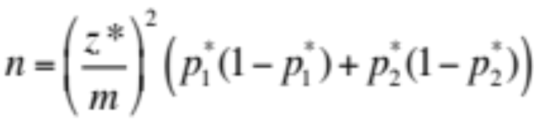
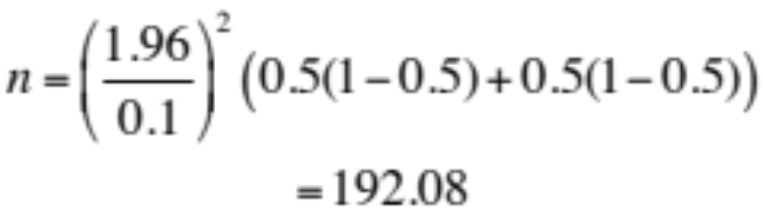
Choosing a Sample Size for Two Sample Proportions
Using the margin-of-error approach
Using the power approach
In the same manner that we used for choosing the sample size for a single proportion, we solve the following equation:
For two samples, the inputs are the true value of p₁ – p₂ in the null hypothesis, the values in the alternative hypothesis, the significance level, and the power. Suppose we want a two-sided alternative at a 5% significance level and a power of 80%. Also assume that p₁ – p₂ = 0, p₁ = 0.6, and p₂ = 0.4.
We would include 192 women and 192 men in our study.
We round down to 192 subjects because 192.08 is very close to 192.
Software output shows us that we should have 97 for each sample.

Slide 31
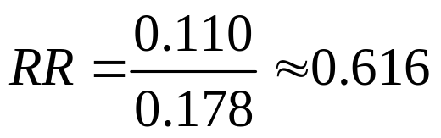
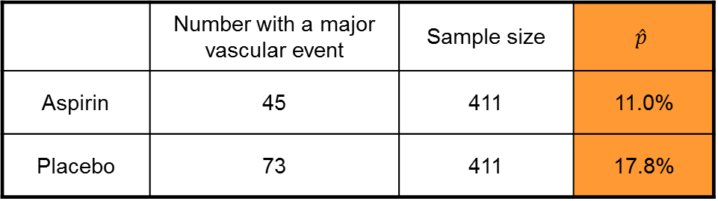
Relative Risk
Another way to compare two proportions is to study the ratio of the two proportions, which is often called the relative risk (RR). A relative risk of 1 means that the two proportions are equal.
The procedure for calculating confidence intervals for relative risk is more complicated (use software) but still based on the same principles that we have studied.
Example: A study of patients who had blood clots and completed the standard treatment were randomly assigned to receive a low-dose aspirin or a placebo treatment. Counts of patients who experienced one or more related medical conditions during follow-up monitoring were reported. One such chart follows.
 | Number with a major vascular event | Sample size | $$\hat{p}$$
Aspirin | 45 | 411 | 11.0%
Placebo | 73 | 411 | 17.8%
Patients using aspirin have 62% of the events that placebo patients have.

Slide 32
Chapter 8
Inference for Proportions (Review)
8.1 Inference for a Single Proportion
8.2 Comparing Two Proportions

